Slide 1
The Definite Integral Session 12-14
Course : MATH 6031 – Calculus
Year : 2021

Slide 2

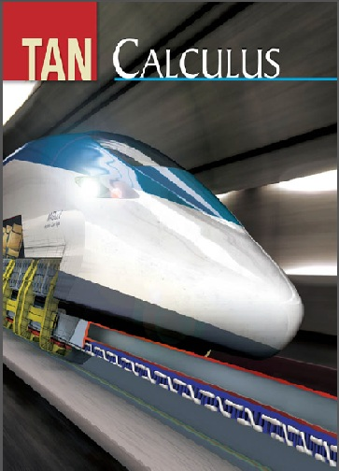
These slides have been adapted from: Dale Varberg, Edwin Purcell, Steve Rigdon. 2007. Calculus. Prentice Hall. ISBN: 978-0132306331. Soo.T.Tan. Calculus. 2010. Brooks/Cole. ISBN-13: 978-0-534-46579-7
Acknowledgement

Slide 3

Learning Objectives
LO 3:
Explain the properties of integral to describe geometric and physical problems, and
other applications.

Slide 4
Content
1
Introduction to Area
2
The Definite Integral
3
The Fundamental Theorem of Calculus
4
The Method of Substitution
5
The Mean Value Theorem

Slide 5
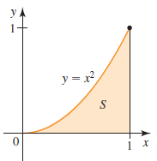
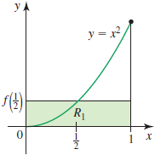
Introduction to Area (1/3)
Consider the region S as picture below
The area A of the region can be approximated by the area A₁ of the Rectangle R_{1 .} Thus,
$$A≈A_{1}=1⋅f\left(\frac{1}{2}\right)=1⋅{\left(\frac{1}{2}\right)}^{2}=\frac{1}{4}$$
The area A of the region can be approximated by the area A₁ of the Rectangle R_{1 .} Thus,
𝐴≈𝐴_1=1⋅𝑓(1/2)=1⋅(1/2)^2=1/4

Slide 6
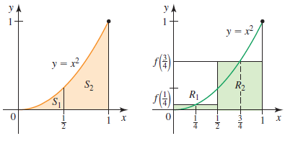
Introduction to Area (2/3)
Approximate the area of S₁ and S₂ by the area of R₁ and R_{2,} respectively.
Denote the sum of the areas of the two rectangles by A₂, we obtain
$$A≈A_{2}=\frac{1}{2}⋅f\left(\frac{1}{4}\right)+\frac{1}{2}⋅f\left(\frac{3}{4}\right) =\frac{5}{16}$$
Denote the sum of the areas of the two rectangles by A₂, we obtain
𝐴≈𝐴_2=1/2⋅𝑓(1/4)+1/2⋅𝑓(3/4) =5/16

Slide 7
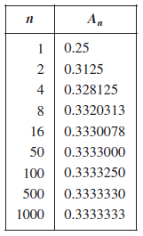
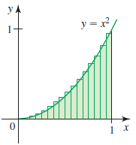
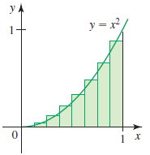
Introduction to Area (3/3)
We can keep going. Figure shows what happens when eight rectangles approximated the area of the region
This figure shows the situation if sixteen Rectangles are used.
The approximations obtained earlier and are rounded off to seven decimal places shows in the table.

Slide 8
Riemann Sums
We call the sum
$$R_{p}=\sum_{i=1}^{n}{f\left(\overline{x_{i}}\right)Δx_{i}}$$
a Riemann sum for f corresponding to the partition P.
We call the sum
𝑅_𝑝=∑_(𝑖=1)^𝑛▒〖𝑓((𝑥_𝑖 ) ̅ )Δx_i 〗
a Riemann sum for f corresponding to the partition P.

Slide 9
Definite Integral
Integrable
Let f be a function defined on the interval [a,b]. If
Definite Integral
Moreover, $\int_{a}^{b}{f(x)dx}$ called the definite integral (or Riemann integral) of f from a to b, is then given by
$$\int_{a}^{b}{f(x)dx}=\lim_{\left|p\right|→0}{\sum_{i=1}^{n}{f\left(\overline{x_{i}}\right)Δx_{i}}}$$
Moreover, ∫1_𝑎^𝑏▒〖𝑓(𝑥)𝑑𝑥〗 called the definite integral (or Riemann integral) of f from a to b, is then given by
∫1_𝑎^𝑏▒〖𝑓(𝑥)𝑑𝑥〗=lim┬(|𝑝|→0)⁡∑_(𝑖=1)^𝑛▒〖𝑓((𝑥_𝑖 ) ̅ )Δx_i 〗
$$\lim_{\left|p\right|→0}{\sum_{i=1}^{n}{f\left(\overline{x_{i}}\right)Δx_{i}}}$$
lim┬(|𝑝|→0)⁡∑_(𝑖=1)^𝑛▒〖𝑓((𝑥_𝑖 ) ̅ )Δx_i 〗
exists, we say f that is integrable on [a, b].

Slide 10
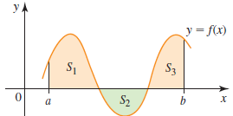
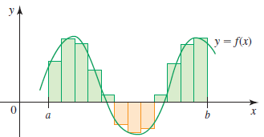
Trapped Areas
Definite Integral
Formula
Specifically,
$$\int_{a}^{b}{f(x)dx}= \text{area} \text{of} {\text{S}}_{1}$$
∫1_𝑎^𝑏▒〖𝑓(𝑥)𝑑𝑥〗=" area of " "S" _1
Graph
If f assumes both
$$\int_{a}^{b}{f(x)dx}=\lim_{n→∞}{\sum_{k=1}^{n}{f(c_{k})Δx}}$$
∫1_𝑎^𝑏▒〖𝑓(𝑥)𝑑𝑥〗=lim┬(𝑛→∞)⁡∑_(𝑘=1)^𝑛▒〖𝑓(𝑐_𝑘)Δ𝑥〗
interpret as a
positive and
negative values on
[a,b], the definite
integral
difference of areas.
$$\text{− }\text{area} \text{of} {\text{S}}_{2}$$
" − area of " "S" _2
$$+ \text{area} \text{of} {\text{S}}_{3}$$
+" area of " "S" _3

Slide 11
Properties of the Definite Integral
Sum
(Difference)
Constant
Multiple
Additive Property

Slide 12
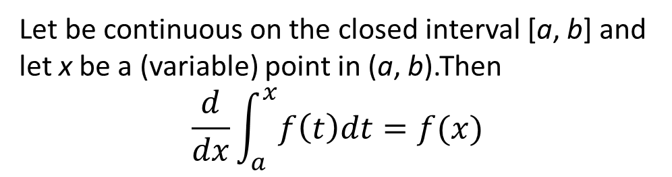
First Fundamental Theorem
of Calculus
Let be continuous on the closed interval [a, b] and let x be a (variable) point in (a, b).Then
$$\frac{d}{dx}\int_{a}^{x}{f\left(t\right)dt}=f(x)$$
It is fundamental because it links the derivative and the definite integral, the most important kinds of limits you have studied so far.

Slide 13
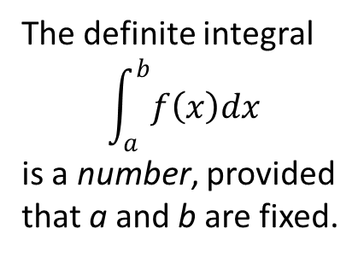


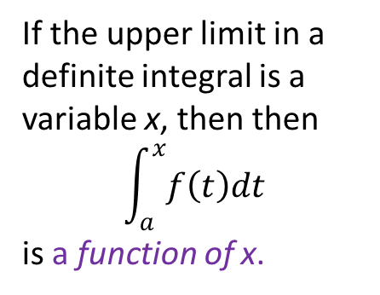
Terminology
The definite integral
$$\int_{a}^{b}{f\left(x\right)dx}$$
is a number, provided that a and b are fixed.
The indefinite integral
$\int{f\left(x\right)dx}$
is a family of functions of x.
1
2
If the upper limit in a definite integral is a variable x, then then
$$\int_{a}^{x}{f\left(t\right)dt}$$
is a function of x.
A function of the form
$$F\left(x\right)=\int_{a}^{x}{f\left(t\right)dt}$$
is called an accumulation function.
3
4

Slide 14
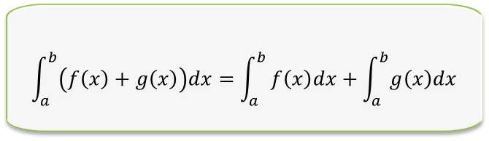
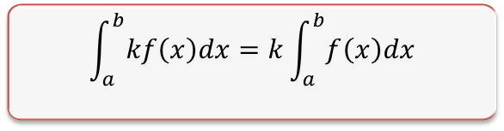

Linearity The Definite Integral
Let f and g are integrable on [a, b] and that k is a constant
2
$$\int_{a}^{b}{\left(f\left(x\right)+g\left(x\right)\right)dx}=\int_{a}^{b}{f\left(x\right)dx+\int_{a}^{b}{g\left(x\right)dx}}$$
$$\int_{a}^{b}{\left(f\left(x\right)−g\left(x\right)\right)dx}=\int_{a}^{b}{f\left(x\right)dx−\int_{a}^{b}{g\left(x\right)dx}}$$
$$\int_{a}^{b}{kf\left(x\right)dx}=k\int_{a}^{b}{f\left(x\right)dx}$$
1
3

Slide 15

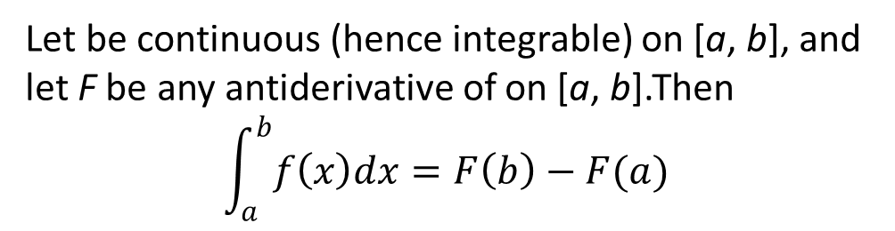
Second Fundamental Theorem
of Calculus
Let be continuous (hence integrable) on [a, b], and let F be any antiderivative of on [a, b].Then
$$\int_{a}^{b}{f\left(x\right)dx}=F\left(b\right)−F(a)$$
Example:
$$\int_{−1}^{2}{\left(4x −6x^{2}\right)dx}={\left[2x^{2}−2x^{3}\right]}_{−1}^{2}$$
$$=\left(8−16\right)−\left(2+2\right)=−12$$

Slide 16
The Method of Substitution
Theorem
Let g be a differentiable function and suppose that F is an
Example
To evaluate $\int{\sin{3x}dx},$ let $u=3x,$ so that $du=3 dx$
To evaluate ∫▒〖sin⁡3𝑥 𝑑𝑥〗, let 𝑢=3𝑥, so that 𝑑𝑢=3 𝑑𝑥
$$∫f\left(g\left(x\right)\right)g^{′}\left(x\right)dx=F\left(g\left(x\right)\right)+C$$
∫𝑓(𝑔(𝑥)) 𝑔^′ (𝑥)𝑑𝑥=𝐹(𝑔(𝑥))+𝐶
antiderivative of f. Then
$$\int{\sin{3x}dx=\int{\sin{u}\frac{du}{3}}}=−\frac{1}{3}\cos{u}+C=−\frac{1}{3}\cos{3x}+C$$
∫▒〖sin⁡3𝑥 𝑑𝑥=∫▒〖sin⁡𝑢 𝑑𝑢/3〗〗=−1/3 cos⁡𝑢+𝐶=−1/3 cos⁡3𝑥+𝐶

Slide 17
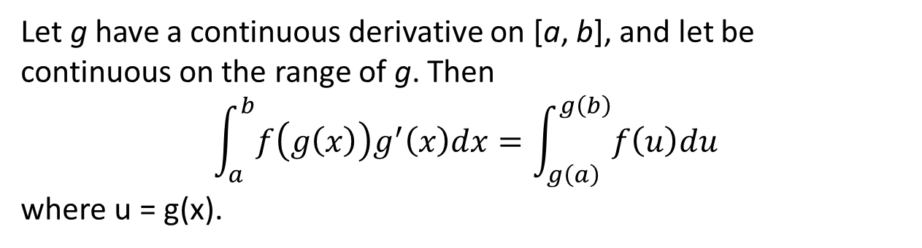
Substitution Rule
for Definite Integrals
Let g have a continuous derivative on [a, b], and let be continuous on the range of g. Then
$$\int_{a}^{b}{f\left(g\left(x\right)\right)g^{′}\left(x\right)dx}=\int_{g\left(a\right)}^{g\left(b\right)}{f\left(u\right)du}$$
where u = g(x).
Make the substitution in the integrand.
Make the appropriate change in the differential.
Change the limits from a and b to g(a) and g(b).

Slide 18
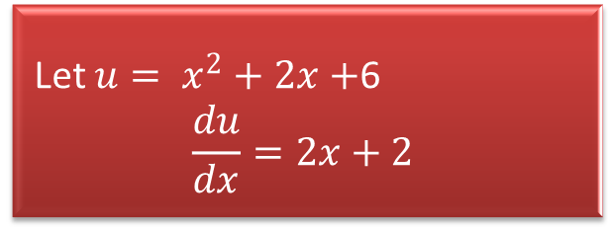
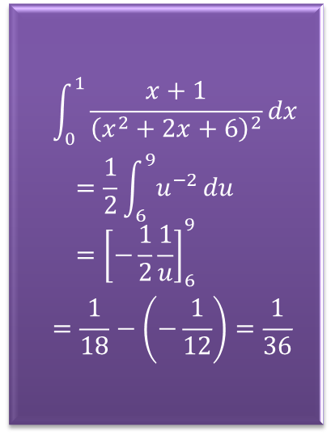
Example
Evaluate$\int_{0}^{1}{\frac{x+1}{{\left(x^{2}+2x+6\right)}^{2}}dx}$
1
3
Let $u= x^{2}+2x+$6
$$\frac{du}{dx}=2x+2$$
$$\int_{0}^{1}{\frac{x+1}{{\left(x^{2}+2x+6\right)}^{2}}dx}$$
$$=\frac{1}{2}\int_{6}^{9}{u^{−2}}du={\left[−\frac{1}{2}\frac{1}{u}\right]}_{6}^{9}$$
$$=\frac{1}{18}−\left(−\frac{1}{12}\right)=\frac{1}{36}$$
2
Note that u = 6 when x = 0 and
u = 9 when x = 1

Slide 19
Some Theorems
1
Average Value of a Function
If f is integrable on the interval [a, b], then the average value of f on [a, b] is
$$\frac{1}{b−a} \int_{a}^{b}{f(x)dx}$$
If f is integrable on the interval [a, b], then the average value of f on [a, b] is
1/(b−a) ∫_𝑎^𝑏▒〖𝑓(𝑥)𝑑𝑥〗
2
Mean Value Theorem for Integrals
If is continuous on
[a, b], then there is a number c between a and b such that
$$f\left(c\right)=\frac{1}{b−a} \int_{a}^{b}{f(x)dx}$$
If is continuous on
[a, b], then there is a number c between a and b such that
𝑓(𝑐)=1/(𝑏−𝑎) ∫_𝑎^𝑏▒〖𝑓(𝑥)𝑑𝑥〗

Slide 20
Example
Suppose the temperature in degrees Fahrenheit of a metal bar of length 2 feet depends on the position x according to the function $T\left(x\right)=40+20x(2−x)$. Find the average temperature in the bar. Is there a point where the actual temperature equals the average temperature?
Suppose the temperature in degrees Fahrenheit of a metal bar of length 2 feet depends on the position x according to the function 𝑇(𝑥)=40+20𝑥(2−𝑥). Find the average temperature in the bar. Is there a point where the actual temperature equals the average temperature?
$$\text{The} \text{average} \text{temperature} \text{is}$$
$$\frac{1}{2}\int_{0}^{2}{\left[40+20x(2−x)\right]dx}$$
$$=\int_{0}^{2}{\left[20+20x−10x^{2}\right]dx}$$
$$={\left[20+10x^{2}−\frac{10}{3}x^{3}\right]}_{0}^{2}={\frac{160}{3}}^{0}F$$
"The average temperature is"
1/2 ∫_0^2▒[40+20𝑥(2−𝑥)]𝑑𝑥
=∫_0^2▒[20+20𝑥−10𝑥^2 ]𝑑𝑥
=[20+10𝑥^2−10/3 𝑥^3 ]_0^2=〖160/3〗^0 𝐹

Slide 21
Dale Varberg, Edwin Purcell, Steve Rigdon. 2007. Calculus. Prentice Hall. ISBN: 978-0132306331.
Dale Varberg, Edwin Purcell, Steve Rigdon. 2014. Calculus Early Transcendentals. Pearson New International Edition. ISBN: 978-1-292-04268-8
Soo.T.Tan. 2010. Calculus. Brooks/Cole. ISBN-13: 978-0-534-46579-7

